Slide 1
Lecture -8
Course Code: CSC 1101
Course Title: Introduction to computer studies
Dept. of Computer Science
Faculty of Science and Technology
Lecturer No: | 08 | Week No: | 08 | Semester:
Lecturer: | Name & email

Slide 2
Lecture Outline
Creating presentation using Microsoft Power Point
Use of different features available in power point to make presentation attractive
Chapter-9,10, IT Essentials
Pseudo code and algorithm.

Slide 3
Specific Objectives
Introduction to MS-power point
Become familiar with Power point
Create a new presentation
Add slides to a presentation
Entering text on slides & Adding a Text Box
Formatting – applying design theme and formatting text
Content Slides & Applying Slide Transitions
Insert graphics and other objects - Inserting an Image and shape
Inserting Hyperlinks & Header and Footer
Printing Slides
Best Practices for Creating Presentations
Description of pseudo code and algorithm
Examples of pseudo code and algorithm
Difference between pseudo code & algorithm
.

Slide 4
MS – Power Point
Microsoft Office PowerPoint is a presentation software application that aids users in the creation of professional, high-impact, dynamic presentations.
Component of a presentation - Slides are the building blocks of a PowerPoint presentation.
By using slides, the focus is not only on the speaker, but on the visuals (slides) as well.
PowerPoint allows to use images, audio and video to have a greater visual impact.
Visual and audio cues helps a presenter be more spontaneous and interactive with the audience.

Slide 5
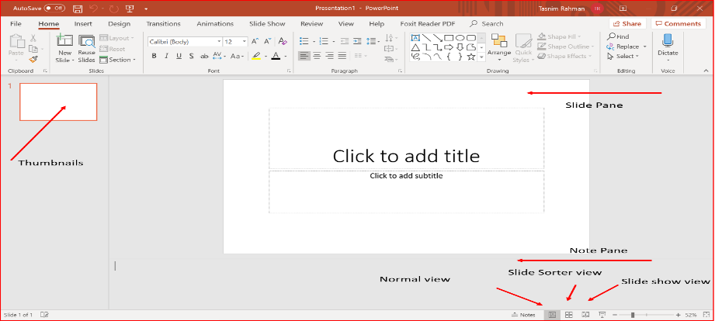
Become Familiar with power point
When you create a Blank Presentation in PowerPoint, the workspace opens in Normal view.
View is divided into three areas:
Slide Pane - shows the full layout of a slide
Thumbnails – shows slide thumbnails
Notes Pane – used to input text relevant to a specific slide
Other views include Slide Sorter view which shows thumbnails of the entire presentation and Slide Show view where you preview your presentation as your audience will see it.

Slide 6
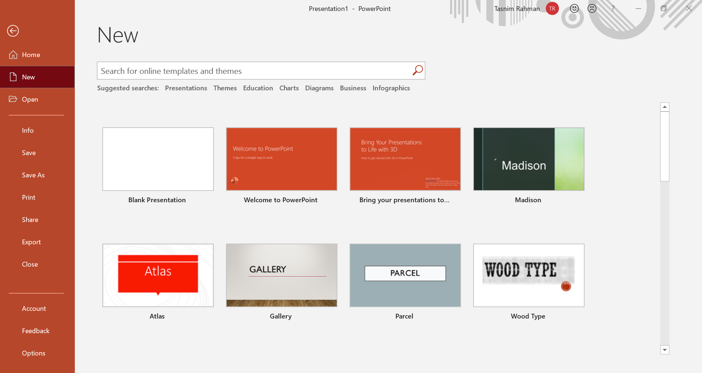
Creating a New Presentation:
To Create a New Presentation:
1.Click on the File tab
2. Click on New
3. Select either a Blank Presentation, a featured theme or search for online templates and themes
4. Double-click Blank Presentation to create a new presentation
5. For saving the file – click on File tab and click ‘save’ or ‘save as’ option.

Slide 7
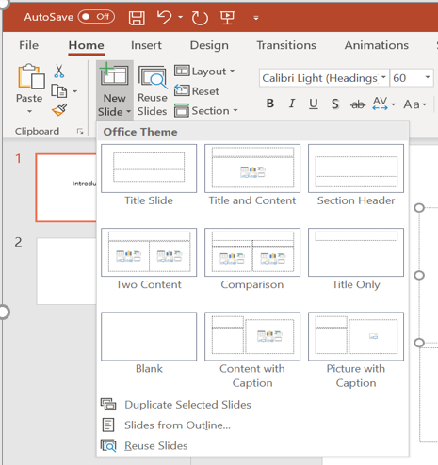
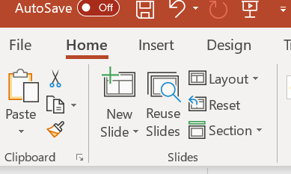
Adding New Slides:
Each slide in PowerPoint has a slide layout.
Slide layouts contain formatting, positioning, and
placeholders for all of the content that appears on a slide.
PowerPoint includes nine built-in slide layouts:
To Add New Slides:
Click on the Home tab
Click on New Slide in the Slides group
Choose a slide layout

Slide 8
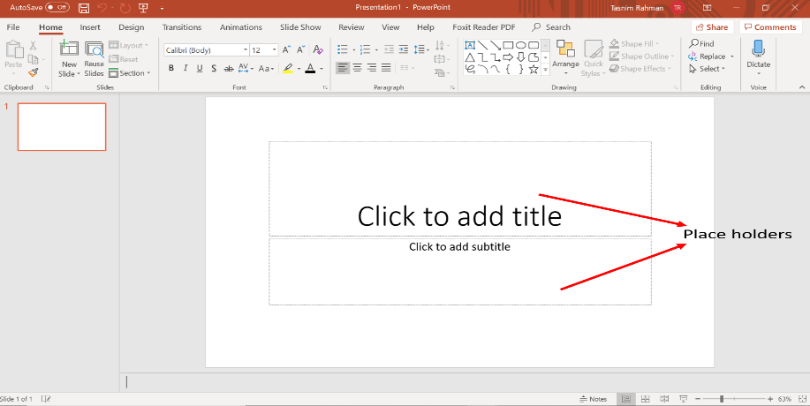
Entering Text on a Slide
When you create a new presentation, the first slide to appear is a Title slide. It contains two placeholders:
a title placeholder and
a subtitle placeholder. To add text, click within the placeholder and type

Slide 9
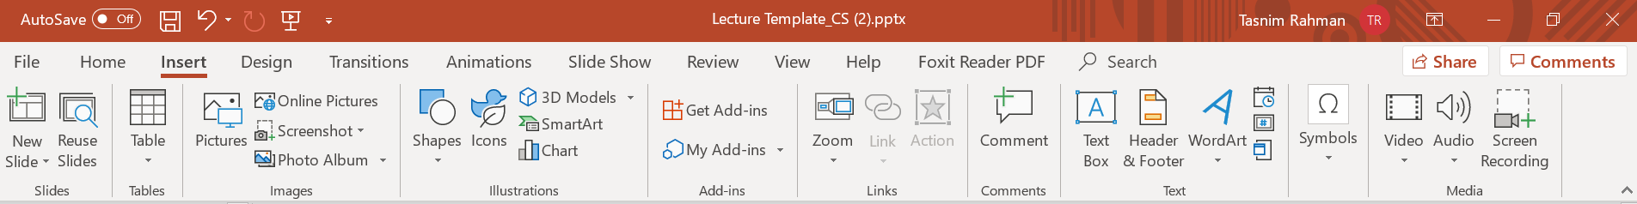
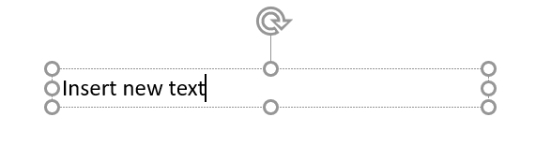
Adding a Text Box:
From the Insert tab, click on Text Box.
Left-click on the area of the slide where you want to add text.
While maintaining the left-click, drag the mouse cursor down a bit and then to the right, then release. The dashed text box appears.
Left-click once inside the text box and start entering your text
1
4

Slide 10
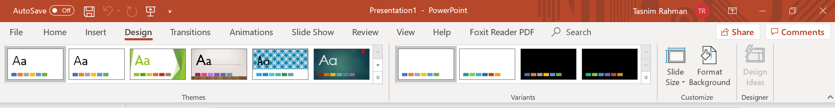
Formatting:
PowerPoint provides a wide variety of themes that apply a distinctive look to the text, bullets, background colors, and graphics in a presentation.
Using a theme is a big time-saver and immediately adds a professional touch to your presentation.
You can apply a theme when you create a new presentation and you can change the theme as many times as you want.
To Apply a Theme:
Click on the Design tab
2) Select one of the themes in the Themes group To see more themes, click on the dialog box launcher

Slide 11
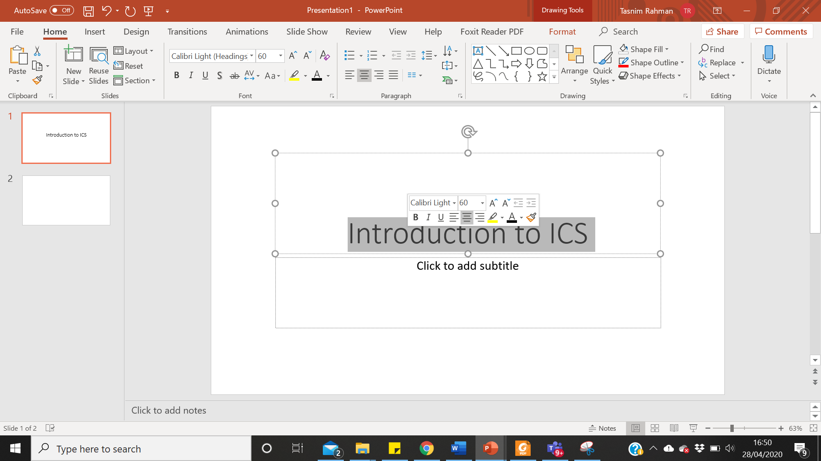
Formatting (cont..)
To Format Text:
Click within the placeholder
Select the text to format
Click on the Home tab
Click on the formatting buttons in either the Font or Paragraph groups
You can also use the Mini Tool Bar that appears when the text is selected

Slide 12
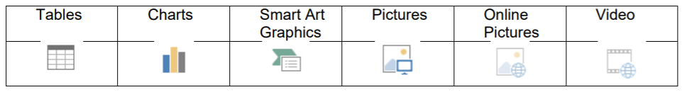
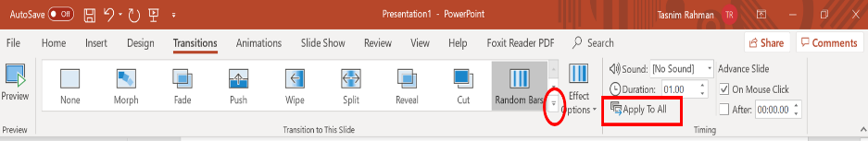
Content Slides:
If you choose a slide with content, you will have six types of content to choose from.
Click on the type of content you want to create and PowerPoint will provide the tools needed to create it.
Applying Slide Transitions
A transition is a special effect that determines how a slide appears as it enters or leaves the screen.
To Apply Transitions:
Click on the Transitions tab
Click on the drop down arrow in the Transition to This Slide group to see a listing of all available transitions
Click on the transition you want to apply
Click on Apply to All to apply the transition effect to the entire presentation

Slide 13
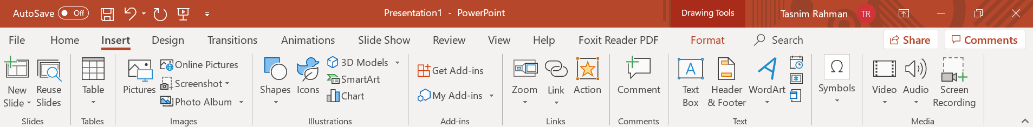
Inserting Graphics and other objects:
Another way to add emphasis to your presentation is to have visual aids or graphics.
You can add images, videos, shapes etc in the slides.
Inserting an Image from a file
Place your cursor where you would like the image to appear.
Select the Insert tab. Click Pictures.
In the Insert Picture dialog box, navigate to find your image. Select your image, and click Insert.

Slide 14
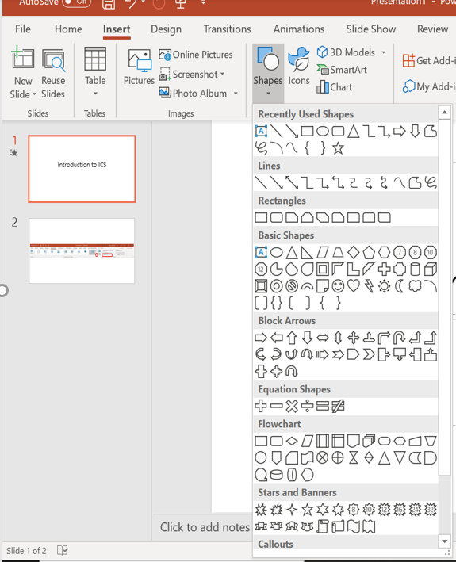
Inserting Graphics and other objects (cont..):
Draw Shapes Shapes are simple geometric objects that are pre-created by PowerPoint and can be modified.
A shape can contain text or can appear without it.
It can also be filled with color, and the outline of the shape can be given a different style and color.
Inserting a Shape:
1. Select the Insert Tab.
2. Click Shapes.
3. Select the shape you wish to draw
4. Your cursor becomes a small black plus sign.
5. In the Slide pane, point the crosshair mouse pointer to the upper-left corner of the area where you want to draw the shape, hold the left mouse button down, and then drag diagonally down to the right to create the shape.

Slide 15
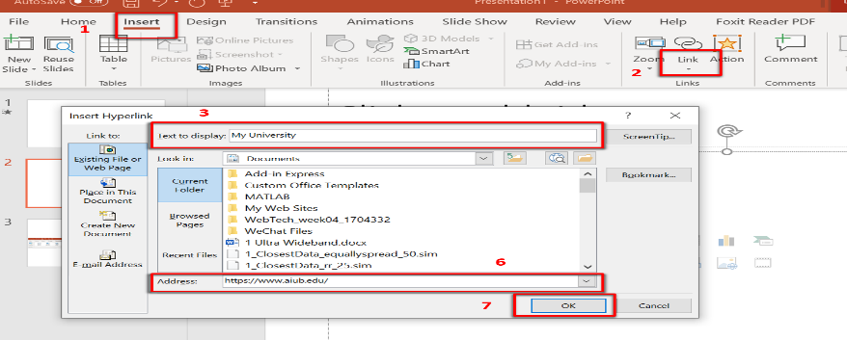
Inserting Hyperlinks:
Adding hyperlinks into your presentation can allow you to quickly jump to supplemental information while you are presenting.
Adding a Hyperlink
Select the text that you would like to change to a hyperlink.
Select the Insert tab
Click Link, then click on ‘insert link’
The text you selected will appear in the Text to Display field at the top of the window. You can change the text if you would like.
Select the location where you want to link to from the Link To column on the left
Type the address that you want to link to in the Address field
Click OK. The text that you selected will now hyperlink to the web address.

Slide 16
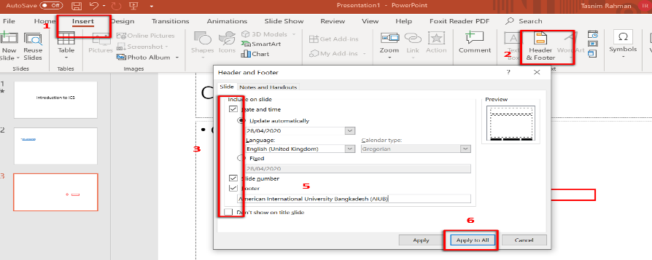
Header and Footer:
It is necessary to add information to the Header or Footer of a PowerPoint presentation,
Adding a Header or Footer
1. Select the Insert tab.
2. Click Header & Footer.
3. Select whether you would like to add these settings to the Slides or Notes and Handouts by selecting the appropriate tab
4. Click inside the checkbox to add the Date and Time or Slide Number
5. Type additional information as author’s name in the Footer box
6. If you would like this information to appear on all slides, click Apply to All

Slide 17
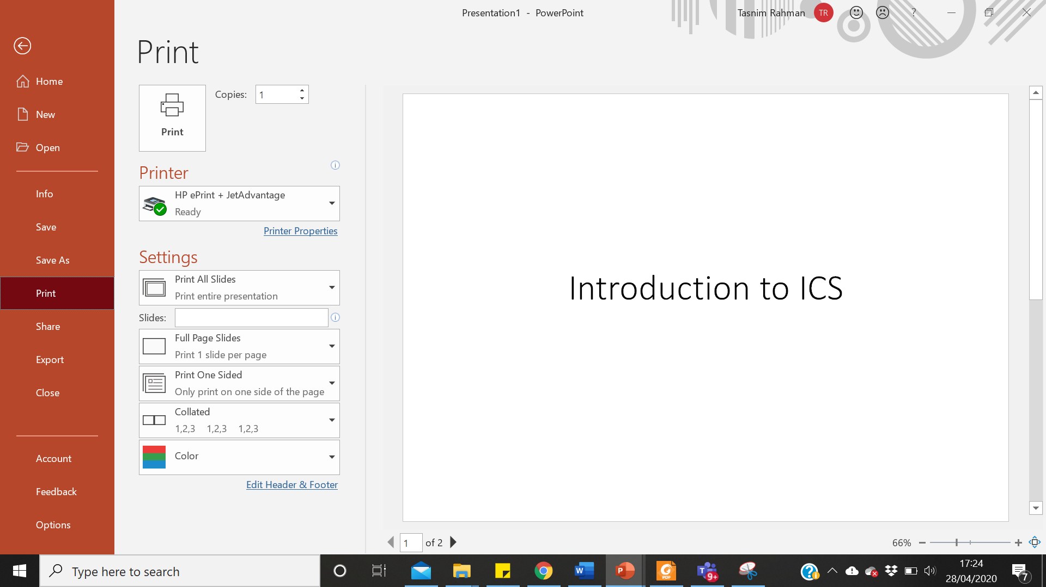
Printing Slides:
Click on the File tab
Click on Print
Under Settings click on Print All Slides and select one of the options to print:
Print All Slides – print entire presentation
Print Selection – only print the selected slides
Print Current Slide – only print the current slide
Custom Range – enter specific slides to print

Slide 18
Best Practices for Creating Presentations
Slide layout, font, colour scheme, and content are the main components to developing a great presentation. Follow the guidelines below to create a good presentation:
Identify the critical information that needs to be presented and include it in your presentation.
Use no more than six bullet points per slide.
Keep bullet points short and to the point.
Keep font sizes consistent.
Do not make all of the text uppercase.
For contrast, use a light-coloured font on a dark background and vice versa.
Use bold formatting to make appropriate words stand out.
Minimize the use of italics. They are more difficult to read.
Do not vary the look of one slide greatly from the next. Consistency is key.
Identify text that can be represented pictorially and use appropriate graphics in its place.
Remove unnecessary graphics that are not relevant to the information presented.
Use consistent colours and font size on each slide.
Do not use unusually bright colours.

Slide 19
Pseudo Code and Algorithm

Slide 20
Algorithm:
An algorithm is a step by step procedure to solve a problem.
A procedure is a finite sequence of instructions, where each is carried out in a finite amount of time.
Every problem can be solved with the help of an algorithm.
For example, when the user wants to login to a Facebook account,
First he has to go to Facebook.com.
Then he has to give the correct username and password.
Then he has to click the login button.
If the username and password are correct, the user can enter his account.
Likewise, every problem has a sequence of steps to solve it. This is also an algorithm because it provides a correct sequence of steps to solve the problem.

Slide 21
WHY DO WE NEED TO BUILD ALGORITHMS?
If we wish to build a house, we need to design it first.
Can you think of some possible consequences of not designing a house before building it?
Similarly, computer programs (especially large and complex ones) need to be designed before they are written.
Can you think of some possible consequences of not designing a program before building it?
One of the things considered when designing a computer program is the algorithm which it will be based on.

Slide 22
ALGORITHMS IN PROGRAM DESIGN
A computer program is built to solve a certain problem.
Examples:
1. A program to calculate the grade obtained given a mark.
2. A program to convert a Gregorian date to an Islamic date.
3. A program to produce a document.

Slide 23
Steps for solving a program
Below are steps (in fact, an algorithm) for building a program to solve a particular problem:
Analyze the problem
Design a computer solution to the problem by developing an algorithm.
Write a computer program based on the algorithm.
Test the program.

Slide 24
Example 1
An algorithm to change a numeric exam result to a letter grade.
Input: One number
if the number is between 70 and 100 then
Set the grade to “A”
if the number is between 50 and 69 then
Set the grade to “B”
if the number is between 40 and 59 then
Set the grade to “C”
Return Grade
End

Slide 25
Example 2
An algorithm that finds the average of two numbers
Input: Two numbers
Add the two numbers
Divide the result by 2
Return the result
End

Slide 26
Classroom Activity-1
Write an algorithm to change a numeric exam result to a pass/no pass grade.
Write an algorithm to find the largest of 1000 numbers.

Slide 27
Pseudocode
Pseudocode is an informal way of writing a program.
It is not exactly a computer program. It represents the algorithm of the program in natural language and mathematical notations.
Usually, there is no particular code syntax to write a pseudocode. Therefore, there is no strict syntax as a usual programming language. It uses simple English language.
An outline of a program, written in a form that can easily be converted into real programming statements.
It resembles the actual program that will be implemented later. However, it cannot be compiled nor executed.

Slide 28
Pseudocode (cont..)
Pseudocode normally codes the following actions:
Initialization of variables
Assignment of values to the variables
Arithmetic operations
Relational operations

Slide 29
Example
Pseudocode to add 2 numbers is as follows;
SumOfTwoNumbers()
Begin
Set sum=0;
Read: num1, num2;
Set sum = num1+num2;
Print sum;
End
Pseudocode to find the area of a Rectangle is as follows:
AreaOfRectangle()
Begin
Read: width, length;
Set area = width * length;
Print area;
End

Slide 30
Classroom Activity-2
Write a Pseudocode to print 5 numbers

Slide 31
Difference Between Algorithm and Pseudocode
An algorithm is an unambiguous specification of how to solve a problem.
Pseudocode is an informal high-level description of the operating principle of a computer program or other algorithm.
Usage
An algorithm helps to simplify and understand the problem. On the other hand, pseudocode is a method of developing an algorithm.

Slide 32
IT Essentials
Chapter 9,10
The module is available on CISCO account.

Slide 33
Reference (for further study)
https://www.microsoft.com/en-us/microsoft-365/powerpoint
https://support.office.com/en-us/article/powerpoint-for-windows-training-40e8c930-cb0b-40d8-82c4-bd53d3398787

Slide 34
References
https://edu.gcfglobal.org/en/powerpoint2016/
https://www.geeksforgeeks.org/how-to-write-a-pseudo-code/
https://pediaa.com/difference-between-algorithm-and-pseudocode/
https://blog.usejournal.com/how-to-write-pseudocode-a-beginners-guide-29956242698

